Slide 1
Flynn's Classical Taxonomy

Slide 2
Flynn's Classical Taxonomy (William Stallings)
There are different ways to classify parallel computers. One of the more widely used classifications, in use since 1966, is called Flynn's Taxonomy.
Flynn's taxonomy distinguishes multi-processor computer architectures according to how they can be classified along the two independent dimensions of Instruction and Data.
Each of these dimensions can have only one of two possible states: Single or Multiple.

Slide 3
Flynn's Classical Taxonomy
Single Instruction Stream , Single Data Stream(SISD)
Single Instruction Stream , Multiple Data Stream(SIMD)
Multiple Instruction Stream , Multiple Data Stream(MIMD)
Multiple Instruction Stream , Single Data Stream(MISD)

Slide 4
1.Single Instruction Stream Single Data Stream(SISD)
IS
IS
PU
DS
MM
CU
SISD Computer

Slide 5
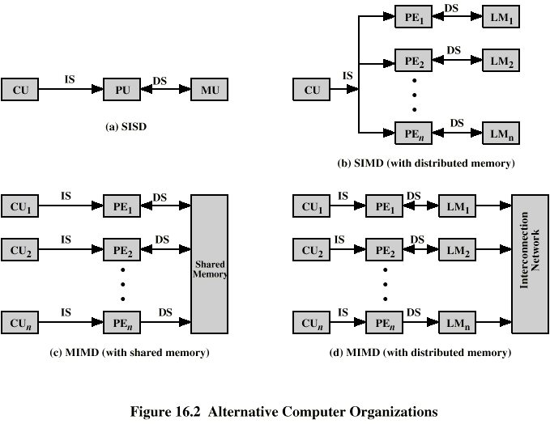
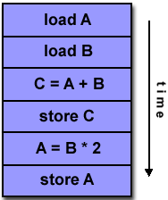
SISD
Single Instruction: Only one instruction stream is being acted on by the CPU during any one clock cycle
Single Data: Only one data stream is being used as input during any one clock cycle
Single processor
Single instruction stream
Data stored in single memory
Uni-processor

Slide 6
2. Single Instruction Stream Multiple Data Stream(SIMD)
This class corresponds to array processors
There are multiple processing elements supervised by the same control unit
All Processing unit receive the same instruction broadcast from the control unit but operate on different data sets from distinct data streams

Slide 7
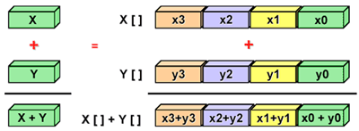
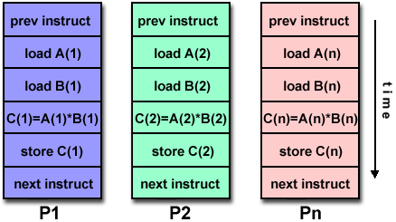
SIMD
Single Instruction: All processing units execute the same instruction at any given clock cycle
Multiple Data: Each processing unit can operate on a different data element

Slide 8
SIMD
Single machine instruction
Controls simultaneous execution
Number of processing elements
Each processing element has associated data memory
Each instruction executed on different set of data by different processors
Vector and array processors

Slide 9
2.1 VECTOR PROCESSING (Morris Mano)
There is a class of computational problems that are beyond the capabilities of a conventional computer. These problems require a vast number of computations that will take a conventional computer days or even weeks to complete.
Vector Processing Applications
Problems that can be efficiently formulated in terms of vectors and matrices
Long-range weather forecasting - Petroleum explorations
Seismic data analysis - Medical diagnosis
Aerodynamics and space flight simulations
Artificial intelligence and expert systems
Mapping the human genome
Image processing
Vector Processor (computer)
Ability to process vectors, and matrices much faster than conventional computers

Slide 10
VECTOR PROGRAMMING
Fortran Language
DO 20 I = 1, 100
20 C(I) = B(I) + A(I)
Conventional computer (Mahine language)
Initialize I = 0
20 Read A(I)
Read B(I)
Store C(I) = A(I) + B(I)
Increment I = I + 1
If I ≤ 100 goto 20
Vector computer
C(1:100) = A(1:100) + B(1:100)

Slide 11
Vector Instruction Format :
ADD A B C 100
Matrix Multiplication
3 x 3 matrices multiplication :

Slide 12
Pipeline for calculating an inner product :
Floating point multiplier pipeline : 4 segments
Floating point adder pipeline : 4 segments
after 1st clock input
A₁B₁
0
0
0
0
0
0
0
after 4th clock input
A₄B₄ A₃B₃ A₂B₂ A₁B₁
0
0
0
0

Slide 13
after 8th clock input
A₈B₈ A₇B₇ A₆B₆ A₅B₅ A₄B₄ A₃B₃ A₂B₂ A₁B₁
after 9th, 10th, 11th ,...
A₁B₁
₊
A₅B₅
A₉B₉ A₈B₈ A₇B₇ A₆B₆ A₄B₄ A₃B₃ A₂B₂

Slide 14
MEMORY INTERLEAVING
Pipeline and vector processors often require simultaneous access to memory from two or more sources.
An instruction pipeline may require the fetching of an instruction and an operand at the same time from two different segments.
An arithmetic pipeline usually requires two or more operands to enter the pipeline at the same time.
Instead of using two memory buses for simultaneous access, the memory can be partitioned into a number of modules connected to common memory address and data buses.
Address Interleaving
Different sets of addresses are assigned to different memory modules
For example, in a two-module memory system, the even addresses may be in one module and the odd addresses in the other.

Slide 15
Vector Processing
Address bus
M0 M1 M2 M3
AR
AR
AR
AR
Memory
Memory
Memory
Memory
array
array
array
array
DR
DR
DR
DR
Data bus
A vector processor that uses an n-way interleaved memory can fetch n operands from n different modules. By staggering the memory access, the effective memory cycle time can be reduced by a factor close to the number of modules.
A CPU with instruction pipeline can take advantage of multiple memory modules so that each segment in the pipeline can access memory independent of memory access from other segments.

Slide 16
2.2 Array Processors
Performs computations on large arrays of data
Attached array processor :
Auxiliary processor attached to a general purpose computer to improve the numerical computation performance.
SIMD array processor :
Computer with multiple processing units operating in parallel
Vector C = A + B c_{i} = a_{i} + b_{i}
Although both types manipulate vectors, their internal organization is different.

Slide 17
Attached array processor
Designed as a peripheral for complex scientific applications attached with a conventional host computer.
The peripheral is treated like an external interface. The data are transferred from main memory to local memory through high-speed bus.
The general-purpose computer without the attached processor serves the users that need conventional data processing.

Slide 18
SIMD array processor
Scalar and program control instructions are directly executed within the master control unit.
Vector instructions are broadcast to all PEs simultaneously
Example: C = A + B
The master control unit first stores the i ^{th} components a_{i} and b_{i} in local
memory M_{i} for i = 1, 2, …, n.
Broadcasts the floating-point add instruction c_{i} = a_{i} + b_{i} to all PEs
The components of c_{i} are stored in fixed locations in each local
memory.

Slide 19
3. Multiple Instruction Stream Single Data Stream(MISD) (William Stallings)
There are n processor units each receiving distinct instructions operating over the same data stream and its derivatives
The result of one processor becomes the input of the next processor .
DS
IS1
IS1
CU1
PU1
MM1
MM2
MMn
IS2
IS2
CU2
PU2
ISn
ISn
CUn
PUn
DS
ISn
IS1
IS2

Slide 20
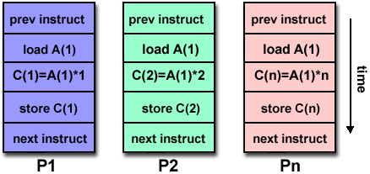
MISD
Multiple Instruction: Each processing unit operates on the data independently via separate instruction streams.
Single Data: A single data stream is fed into multiple processing units.

Slide 21
MISD
Sequence of data
Transmitted to set of processors
Each processor executes different instruction sequence
Never been implemented

Slide 22
4.Multiple Instruction Stream Multiple Data Stream(MIMD)
All memory streams are derived from the same data space shared by all processors
It is a set of n independent SISD uniprocessor systems
IS1
DS1
IS1
CU1
PU1
MM1
IS2
IS2
DS2
CU2
PU2
ISn
MM2
ISn
DSn
CUn
PUn
MMn

Slide 23
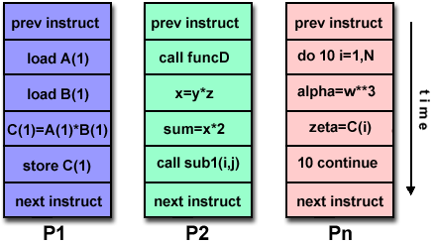
MIMD
Multiple Instruction: Every processor may be executing a different instruction stream.
Multiple Data: Every processor may be working with a different data stream.

